Slide 1
The small pleasures of life
Kaisa Maliniemi & Karin Larsen
The Kven Institute in Norway

Slide 2
Questions
Hvilke minner fra barndommen om oppplevelser, som gledet deg, husker du best?
Hva gir deg små gleder i dag?
What kind of memory from childhood, that gave you joy, do you remember well?
What do give you small pleasures of life today?

Slide 3
Background of participants
3 young adults, 20-23 years old
4 adults, 49-59 years old
5 females
2 males
2 Finns
1 Finn - Norwegian
2 Kvens
1 Sami - Kven - Norwegian
1 Norwegian

Slide 4
Female 20 years
My first memory of joy or real happiness was when I got my first Barbie-dollhouse at the age of 4-5. I remember going to the store with my parents and pointing at a Barbie-dollhouse, saying that I wanted it. I really wanted it, but never thought that I would ever get it. But when Christmas finally came I got a really big present. And to my surprise it was the dollhouse. My parents have told me the story many times. I cried because I was so happy. I never thought in my wildest dreams that I would get it. Of course it is ruined now, but this is 15 years ago and I still remember it today.
My memory of joy today is every time I meet my family and old childhood friends from my hometown. It reminds me of my childhood, of being young and never has to worry about stuff like paying bills and going to work/school. And of course, the fact that I love them all.

Slide 5
Small pleasure of life: playing with friends

Slide 6
Male 23 years
As a child, some of the small pleasures I remember the most, is lying in our small cottage at the summer dairy late at night, catching all the confident and recognizable noises from outside through the thin walls into the bedroom. The river, the wind and the rain, the goats in the summer barn next door, but also the sounds from the stove and the grownups talking to late at night. Their conversation went in a melody inspired from their “kveeni”-speaking forefathers, which is more than unique. This small and confident pleasure will never return, but will never be forgotten.
Nowadays, as a young grownup, some of the small pleasures might be all the memories from a bygone era from the childhood. I still remember all those small farms around in our village, when the summer barn was still alive, I remember people doing hay racking and I even remember old farmers in my childhood using two wheeler and scythe! A wonderful time and people were more related to each other. Those days are gone. Now, everything is based on big farms and high income, while the villages die slowly but surely.

Slide 7
The first ray of sunshine after three-month polar night

Slide 8
Ivar 52 years: What gives me the greatest pleasures?
That’s a question with multiple answers. Pleasures are connected to senses, and being a hedonist, I am easily pleased. Just give me some: God food, and living so close to the Barents sea, especially seafood... Fresh cod, damped in white wine on a bed of seafood, served with a sauce of sour cream with shrimps, thyme and saffron, and baked root vegetables is enough to give my tears in my eyes and joy in my belly! Good beverage, like an old Barolo, the perfect lubricate for my body.... A cultural experience, like some music from my favorite artist or a movie that blow my mind, that gives nutrient to my mind... A nature challenge, like climbing a mountain, with the satisfaction of standing on the top, physically exhausted the ultimate pleasure for my soul… Spice all that with the pleasure of having my girl in my arms, feeling the heat of her body and reading love in her eyes and my life is complete. I am a simple Kven, and need nothing more, to be pleased!

Slide 9
Pavlova made by children

Slide 10
Synnøve 59 year: What made me happy as a child and what brings me joy as a grown up in the Artic
A particular joyful and sensuous experience from my childhood is the taste, and also the smell of the sweet honey melon. We never had dessert except Sundays so getting such a surprise like this in the middle of the week was a rare experience to us children. It was almost like party-time when mum came home with this unfamiliar and non-arctic round thing that smelled so good. I don't think I am able to describe the feeling that ran through my body when setting my teeth into that incredible juicy fruit meat, Oh my, such a taste!
To be read to was a joy; the first book I think I remember was Ragdolly Anna. Then later discovering letters and learning the art of reading was both exiting and joyful, I remember well spelling my way through the tales in 'Thousand and One Night'. I found it the bookshelf of our landlady, she lived at the 1st floor and she had lots of books, different books than we had. We did not have that many. I sat totally quiet for a long while. I guess it would not have been the literature my mother wanted me to read
The day I mastered the bicycle was a great day and I also loved climbing trees
Sometimes she invited me up for a cake; a little round cake made of cream and marzipan, it tasted like a secret heaven I imagine now...

Slide 11
As grown up taste is still a big and blissful issue, sometimes a piece of bread with butter and a good cheese make me feel happy and content, and not the least the taste of yellow yolk of a fried egg, I use to eat around the yolk and save it whole to put all in my mouth, it fills my sense with delight. Or a good steak and a wine
It gives me a lot of pleasure and joy to hike in the mountains on a late August day when the summer still can be warm in the Arctic. I love to go to my little cabin on an island where no one lives anymore and even more joyful, when it happens, to have a short swim in the ocean and then get up and get warm again. It's not every summer that happens.
To read still gives me a lot of joy, a good novel or a poem or an exciting article. I also still enjoy a bicycle ride and I was very excited, happy and very proud when I got my driving license at the age of 43
Being in motion is the best, I feel alive and most happy when I travel around and can't be reached by other than those who are travelling the same road, boat or plane - I enjoy very much sitting by a window seeing the land-, air- or seascape float by, and looking forward to what happens next.

Slide 12
The first sign of summer: the sound of seagulls

Slide 13
Conclusions
Answers are not presentative as a studie
Friends, familily and careless life seem to be important for young adults
Food, drink and nice experiences like nature seem to be small but imporant pleasures of life for adults
There are not big differences between persons with different background

Slide 14
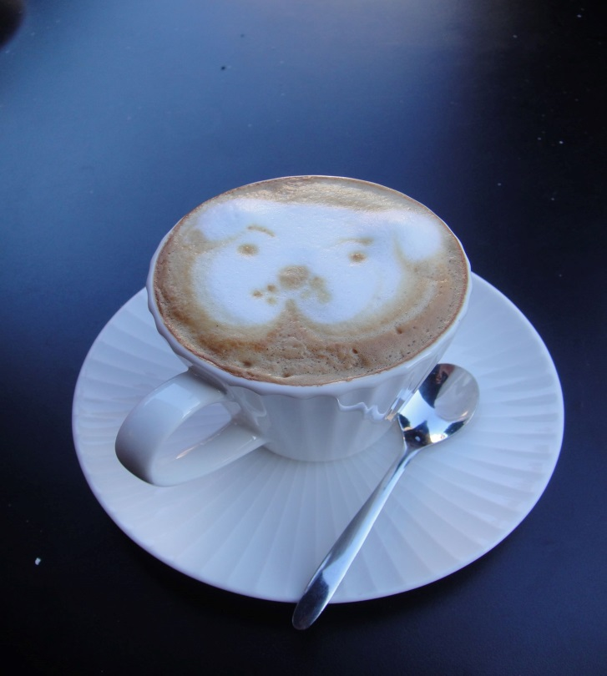
Thank you for your attention!
Takk for oppmerksomheten!
Kiitoksii paljon!

