Slide 1
Resume of interviews about memories related to senses
Our very organism holds memories and glimpses of that long life of our ancestors which still goes on among so many of our contemporaries.
Jane Addams (1860–1935), U.S. social worker and social reformer.
http://quotes.dictionary.com/We_all_bear_traces_of_the_starvation_struggle#21kluPJ5Pj7b2EsR.99

Slide 2
Questions for the interviews about memories related to senses
When you think about your childhood what images or scenes come to your mind?
Which of the things you touched left the strongest feeling in you?
Do you remember any noises, sounds, music that had a strong influence on you?
Are there any tastes that you associate with your childhood or your past?
Can you think of any smell that you will never forget?
Are there any historical events which had an impact on you or somebody close to you?

Slide 3
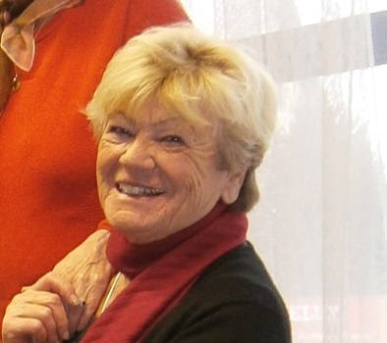
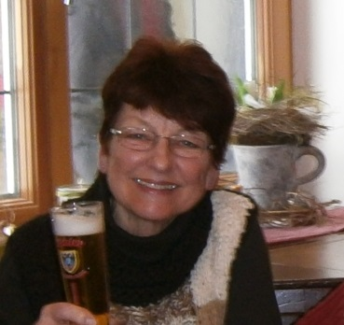
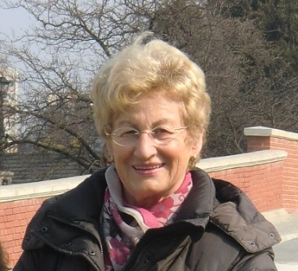
The persons who answered the questions
Celia, 50, in Portuguese Christa, 54, in English Dolores, 59, in English Gerda, 68, in English Hanni S., 66, in German Harry, 74, in English Heidi, 54, in English | Hélène, 65, in French Helga D., 67 in German Helga H., 72, in German Ilse, 65, in English Marcelina, 45, in English Natalie, 31, in German Wolfgang D., 67, in German

Slide 4
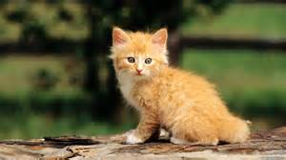
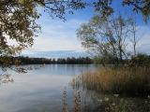
Common points in the answers:
Childhood:
Lot of memories where bound to the relationship to the mother.
For the elder ones the memories after the Second World War were very present.
For most of the persons answering the questionnaire nature and living with the nature were important point in their past.
Touching:
Persons and animals were the most relevant memories related to that sense. Especially taking children in one´s arms.
The most mentioned animal was “cat”.
Music and sounds:
There, too, the elder generation had common remembrance of Elvis Presley, the Beatles, the Rolling Stones, e.g.

Slide 5
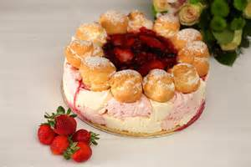
Tastes:
Most of the tastes people were speaking about, were related to cakes, sweets, homemade products, “Mum’s cooking” which was the most important memory,….
Smell:
Lots of memories were bound to the smell of nature (fields, forest, meadows, flowers, ….) but also to things to eat (cakes, bread – after the war….) and to perfumes.
Historical Events:
The Second World War and the effects of it were important for the elder generation, even if the answering persons were mostly born after the war.
More recent events like the attack on the World Trade Centre, J.F. Kennedy ´s death and the landing of the moon were mentioned, too.

Slide 6
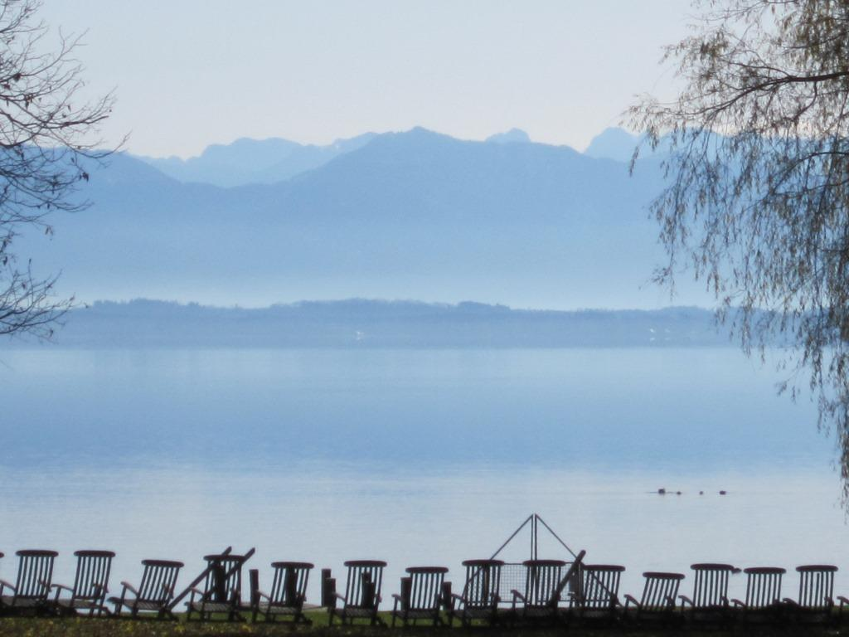
Thank you for your attention!
This project was funded with support from the European Commission. The content reflects the views only of the authors, and the Commission cannot be held responsible for any use which may be made of the information contained therein.

