Slide 1
Memory Boxes Norway

Slide 2
In February a two days course: How to make digital stories
We used apple stories as a course material
Stories, photographs, film technology and theory
Digital storytelling is a relatively new term which describes the new practices of ordinary people who use digital tools to tell their story
It can offer a helping hand in other contexts, for example in creation of learning materials and in teaching situations

Slide 3
Our teacher Inger Birkelund

Slide 4
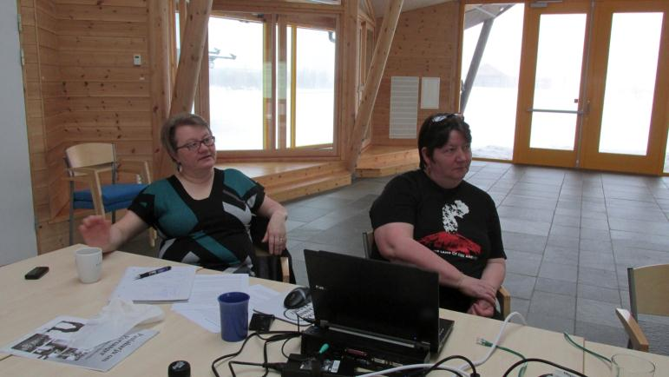
Two of our students: Karin and Wigdis

Slide 5
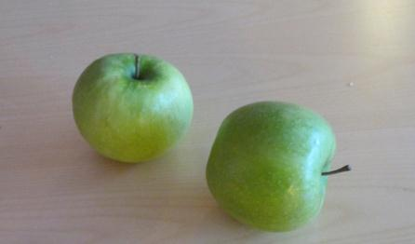
On Youtube:
Wigdis´s story in Norwegian: http://www.youtube.com/watch?v=HvfrpGdV-kY&feature=youtu.be
Karin´s story in Kven:http://youtu.be/kMDLeVqRRIY

Slide 6
Interviews of persons over 65 years old in Børselv/Pyssyjoki, North of Norway
Interviews and film made by Karin Larsen and Wigdis Farstad

Slide 7
Questions for the interview
When you think about your childhood what images/ scenes come to your mind?
Which of the things you have touched left the strongest feelings in you?
Do you remember any noises, sounds, music, songs that had a strong influence on you?
Are there any tastes that you associate with your childhood or your past?
Can you think of any smells that you will never forget?
Are there any historical events which had an impact on you or somebody close to you?

Slide 8
Questions in Norwegian/Spørsmålene på norsk:
Når du tenker tilbake til din barndom, hvilke bilder/synsinntrykk husker du best?
Hvilke ting som du har berørt, har gitt sterkeste følelser?
Husker du noe lyd, båk, stemme, musikk, sang som har hatt en sterk påvirkning til deg?
Finnes det noen smak som du forbinder til din barndom eller fortid?
Kan du huske noen lukt som du aldri vil glømme?
Finnes det noen historiske hendelser som har påvirket deg eller noen nært deg?

Slide 9
Questions in Kven/Kysymyksii kvääniksi:
Ko sie hunteeraat ommaa lapsuutta, niin mitä kuvvii/ muistokuvvii sie muistat parhaiten?
Mitkä tavarat, joita sie olet koskettannu, oon antanheet vahvan tuntheen?
Muistatko joitaki äänii, sävelii, musikkii tahi laului jokka oon vahvasti vaikuttanheet sinhuun?
Oonko olemassa joku maku, jonka sie muistat menneisyyđestä tahi siltä aijalta ko sie olit lapsi?
Oonko olemassa joku haiju, mitä sie et koskhaan unheeta?
Muistatko jonku histoorillisen tapattuman, mikä oon vaikuttanu sinhuun tahi sinun lähimäissiin?

Slide 10
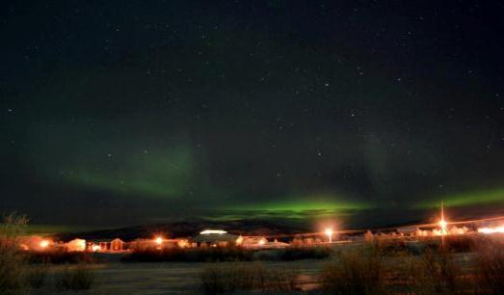
Interview objects:
3 men
2 women
All persons from Børselv/Pyssyjoki
4 interviews in Kven and 1 in Norwegian

Slide 11
Arvid 78. Interview in Norwegian:
I remember very well one late summer night when there were a lot of herrings in the fjords. It was like a lightning on the surface of the water because of herrings.
I got a boat made of wood by my grandfather. He was a good carpenter.
It was at a party and one man from Balsfjord played an accordion. I was so lucky because I heard him later when I was a grown up. I remember that very well. His name was Kåre Pettersen.
Yes, one of the worst possible connection. I was traveling by boat around the North Cape, and it was a terrible weather. I was seasick. One of the crew said that gammel ost (Norwegian cheese that looks and smells strong) could help against seasickness. I can´t forget that. It was terrible.
The smell of fish, cows and sheep.
Yes, in 1952 there was a huge boat tragedy in Vesterålen: 5 boats and 80 men disappeared in the ocean. My father was there with his boat, but he managed to save himself to Iceland. He was missed in ten days. I was working on the boat at that time when the officer of the boat came and told me that my father was in safe. I am never going to forget that.

Slide 12
Solveig 72. Inteview in Kven:
1.The first thing I remember was early in the springtime 1945. We didn´t have so much food left. For a long time we had mostly eaten bread with creosote that Germans had pour over and thrown them away. My mother used to gather these, cut the creosote away and heated them in the oven. Then we heard that a big boat with lot of food had arrived in Holmfjord. I remember that my father went there and came back with flour and butter. At once when he came home he threw the whole pan of bread out for crows. We baked bread in the oven. The freshly baked bread with butter was delicious.
One other incident that I remember well was when my brother died. I was 14 and he was 18. He drowned in Alta. It was Sunday and my mother was in a child baptism in church. My brother Ingvald was supposed to go there too. This was the last time when we saw him. We didn´t know that something was wrong before my mother came back from the church. When we looked at our mother we knew that something terrible had happened. It was hard to us but it was hardest to our mother and father. Even thougt children cope with grief in different ways than adults, we never forgot our brother and we missed him.

Slide 13
After the war. My hands ware burned by hot coffee. I had to hold my hands in the water so that it didn´t hurt so much.
Songs, of course. It was the first time when I heard the choir sang Christmas songs in Kven in church in Børselv. I got tears in my eyes because I haven´t heard them since I was a child.
Dried meet of lamp, baked in the oven.
Grass that grows in Børselv. My mother used to pick them up and put them in to shoes made of reindeer skins. They smell nice a long time after, they smell like a perfume.
The 17th of May in 1945, straight after the war. We went to the top of the hill to watch the celebration of the national day. We could not join the celebration because we had bad clothes on. We knew that there was a lot of good food. My mother took us home and baked bread with rosins and cooked hot chocolate for us.

Slide 14
The comparison of answers:
Not representative statistically but we can find some trends
Nearly everybody remember the war in one way or another
The biggest difference between the answers was related to ethnic elements
The answer in Norwegian describes typical Norwegian themes; fish, ocean, boat
Most of the answers in Kven describe memories related to use of Kven language like songs
One person answers that he remember one teacher who punished them if they used Kven language. Kven was a forbidden language at school.

Slide 15
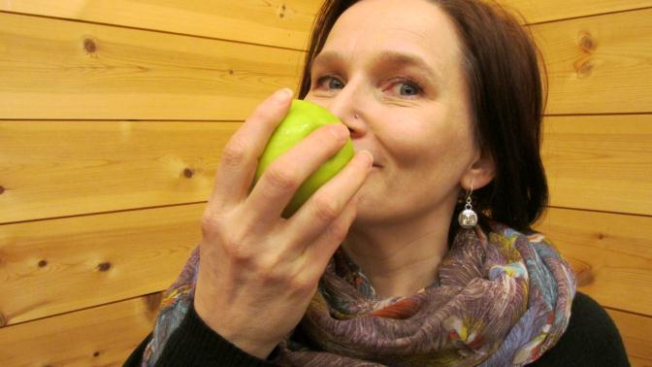
Thank you!

